Slide 1
Oil News Headline Analysis And Oil Price Prediction
Group11 member
Gui Yilin(A0215649X)
Peng Wenhui(A0215672E) Shen Jianxin(A0215679R) Wang Yi(A0105493H)
Yan Yucheng(A0215633L)

Slide 2
Overview
01

Slide 3
Overview
1.Forecasting oil price based on historical oil price.
2.Some interesting work on the oil news headline.

Slide 4
Background
02

Slide 5
Background
1.oil is a very important energy and also play an important role in financial market. The fluctuation of the oil price affects every field of economy.
2. There are many crude oil derivatives, such as futures. Many investors hope to make profit by trading crude oil derivatives.
3.If we can predict the crude oil price to some precision, we can make decisions or gain some profits from prediction.
4.Beside predicting from historical data, when we talk about oil prices, we inevitably talk about oil-related news.

Slide 6
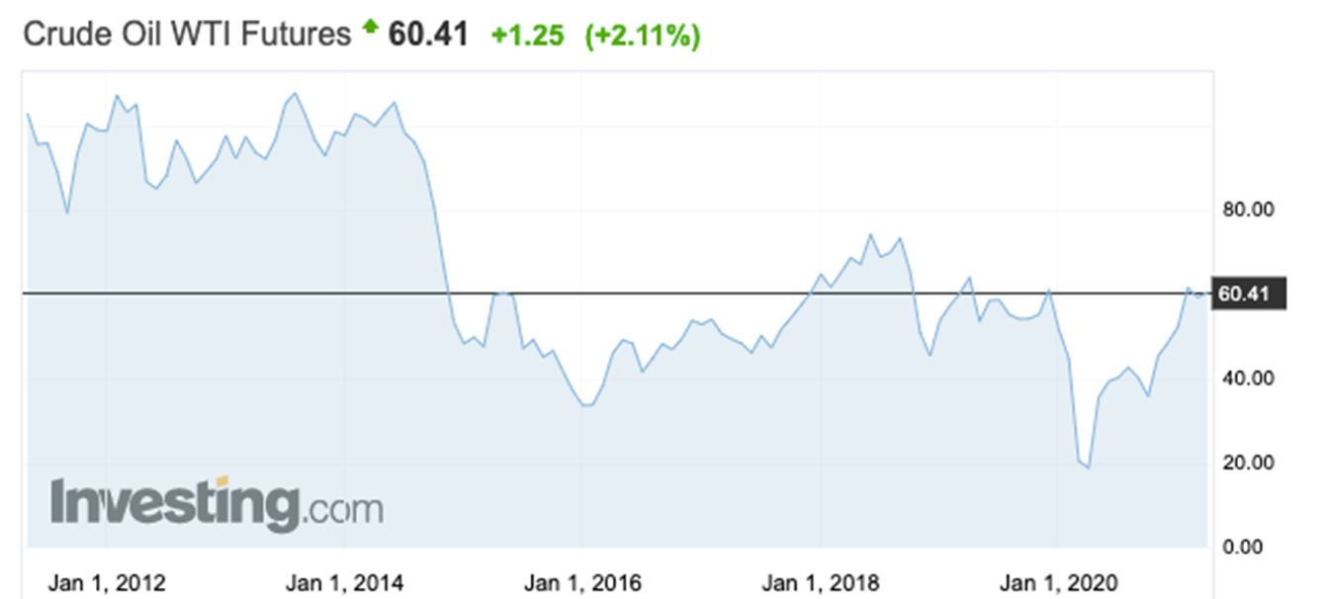
Background
Why we do this?
But oil price is very hard to predict due to its high volatility(待考证）

Slide 7
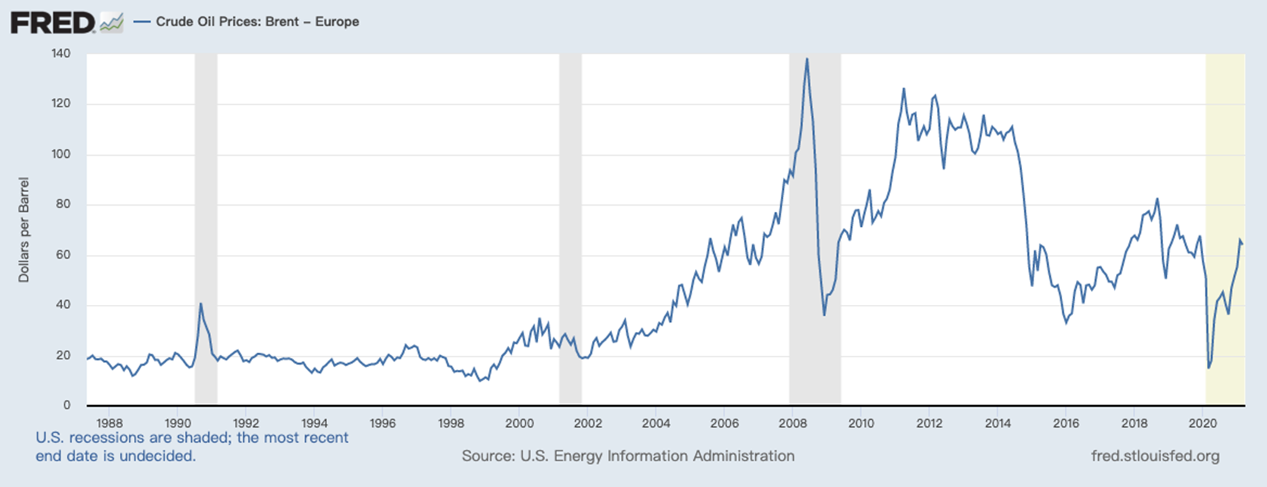
Background
Furthermore, oil price volatility seems to have increased over time.

Slide 8
Background
LSTM model v.s ARIMA
LSTM is more suitable for long-term model while ARIMA perform better in short-term model.
In this case I think LSTM is better.

Slide 9
Oil price forecasting-LSTM
03

Slide 10
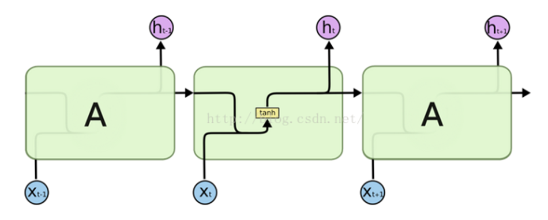
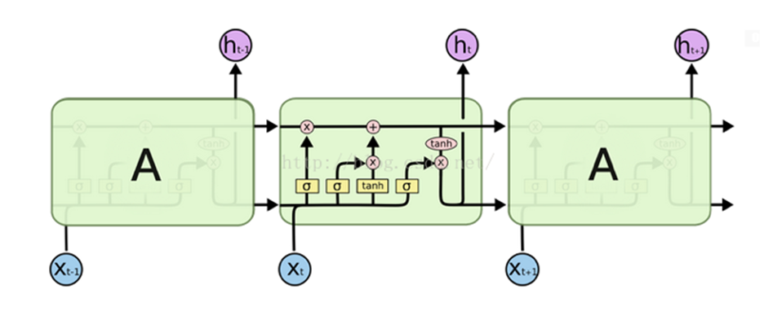

Oil price forecasting-LSTM
1.Brief introduction to the LSTM model
LSTM is a special RNN model.
Standard RNN model v.s LSTM model
Standard RNN
LSTM

Slide 11
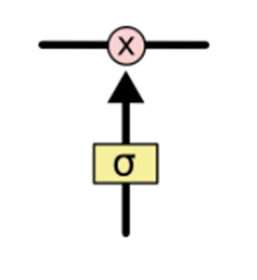
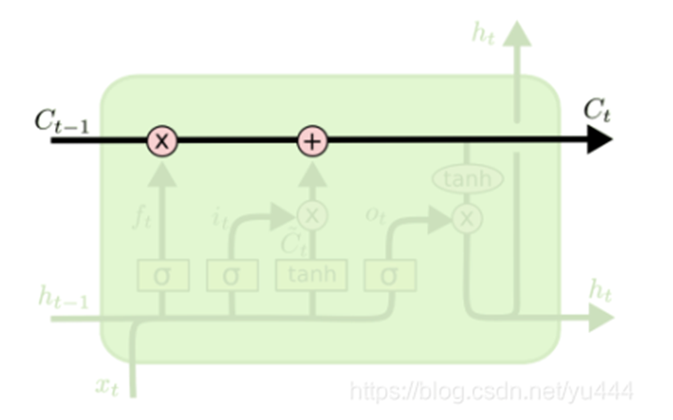
Oil price forecasting-LSTM
Cell state
Gate

Slide 12
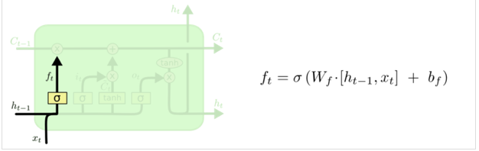
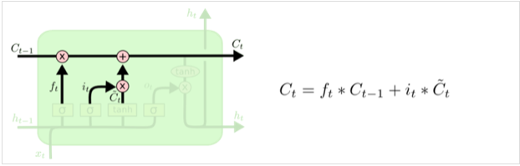
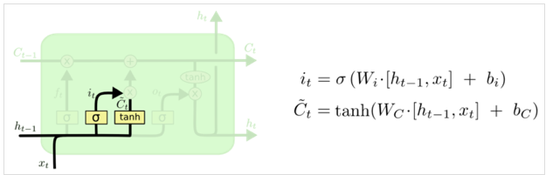
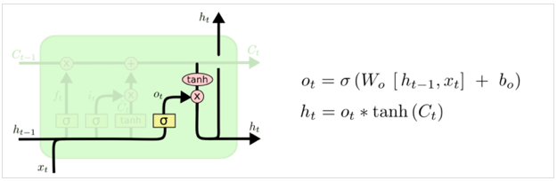
Oil price forecasting-LSTM
Forget gate
Update cell state
Input gate
Output gate

Slide 13
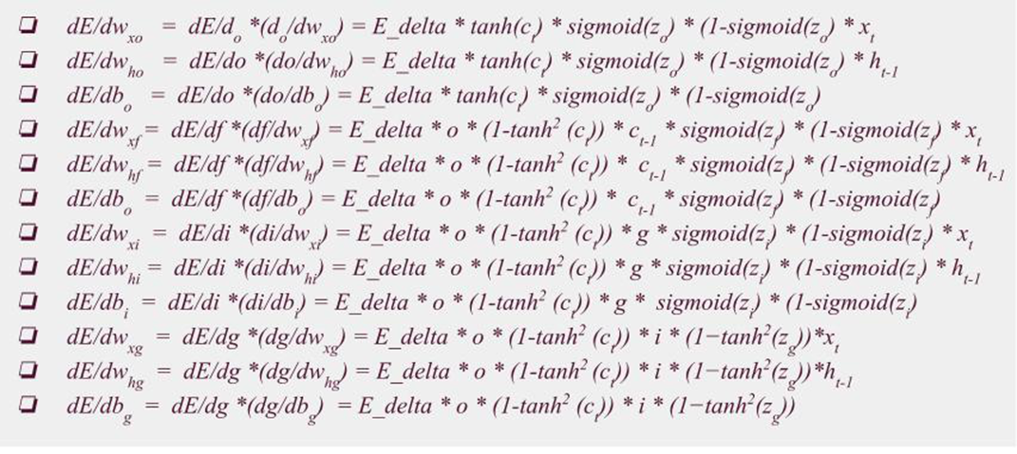
LSTM backward Propagation
Step 1 Initialization of the weights
Step 2 : Passing through different gates
Step 3 : Calculating the output ht and current cell state ct.
Step 4 : Calculating the gradient through back propagation through time at time stamp t using chain rule
Finally we can get the weights:

Slide 14
Baseline model: Oil price forecasting-LSTM
Dataset
Data source:
U.S. Energy Information Administration, Crude Oil Prices: Brent - Europe [DCOILBRENTEU], retrieved from FRED, Federal Reserve Bank of St. Louis; https://fred.stlouisfed.org/series/DCOILBRENTEU,
MinMaxScaler to rescaling data into [0,1]
x: past 30 prices
Label: 30 prices after x

Slide 15
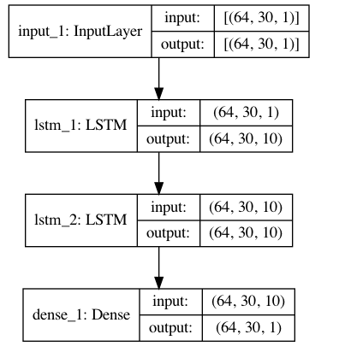
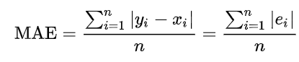
Baseline model: Oil price forecasting-LSTM
Loss function:
Mean Absolute Error

Slide 16
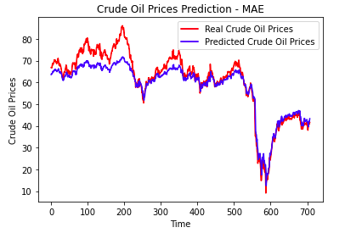
Baseline model: Oil price forecasting-LSTM
Mean Absolute Error:
3.3460338852230445

Slide 17
Multivariate : Oil price forecasting-LSTM
Dataset
Data source: Bloomberg and U.S. Energy Information Administration, Crude Oil Prices
MinMaxScaler to rescaling data into [0,1]
past 30 prices
Label: 30 prices after x

Slide 18
Crude Oil Price influence factors
Demand
International Energy Agency Crude Oil Demand Non-OECD
International Energy Agency Crude Oil Demand OECD
Supply
Global Crude Oil Floating Storage
Index from Research Institute
S&P Global Oil Index
S&P Oil&Gas Exploration & Production Select Industry Index
Dow Jones U.S. Oil&Gas Total Stock Market Index
MSCI Global Alternative energy Index

Slide 19
Crude Oil Price influence factors
Financial Market
SP 500 index
VIX Index
Crude Oil Futures
US Dollar Index
Dow Jones U.S. Oil&Gas Total Stock Market Index
Source:Bloomberg

Slide 20
PCA Selection Result
 | PC | ticker | name
0 | PC0 | VIX Index | VIX Index
1 | PC1 | OPECDALY Indexl | OPEC Daily Index
2 | PC2 | SCP1 COMB Comdty | Crude Oil Futures
3 | PC3 | GEAE Index | MSCI Global Alternative Index
4 | PC4 | SPSIOP Index | S&P Oil&Gas Exploration & Production Select In...
5 | PC5 | SPX Index | SP 500 Index

Slide 21
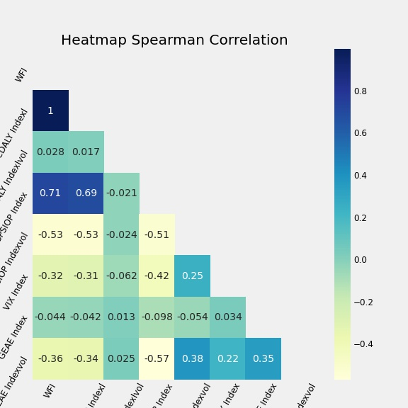
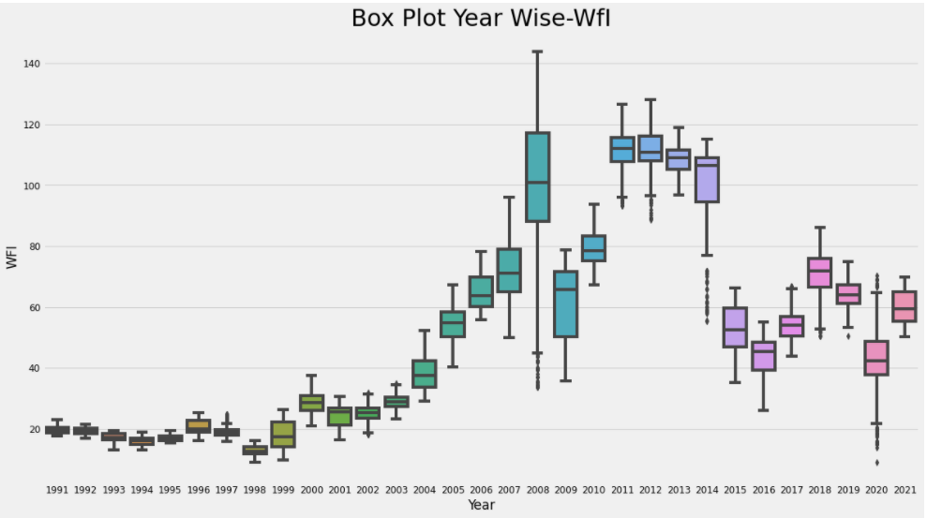
Exploartory Data Analysis

Slide 22
LSTM Multivariate Prediction
Parameters:
Layers = 4
Units = 30
Dropout = 0.2
Epochs = 50
Batch_size = 32
Tuning
Layers = 4
Epochs = 50

Slide 23
Outlier Removal Techniques
(Method-1) Financial Crisis Outlier Removal (2007-2009)
Drop data between 2007.06 to 2009.06
(Method-2) Z-Score Outlier Removal Technique
Drop data with z-score larger than 2.5
(Method-3) Mahalanobis Distance Outlier Removal Technique
Mahalanobis distance is distance between two points in a multivariate space. It can be effectively used to eliminate outliers when
1.There is correlation with target variable.
2. Multi-dimensional distance is possible otherwise not possible in Euclidean distance.

Slide 24
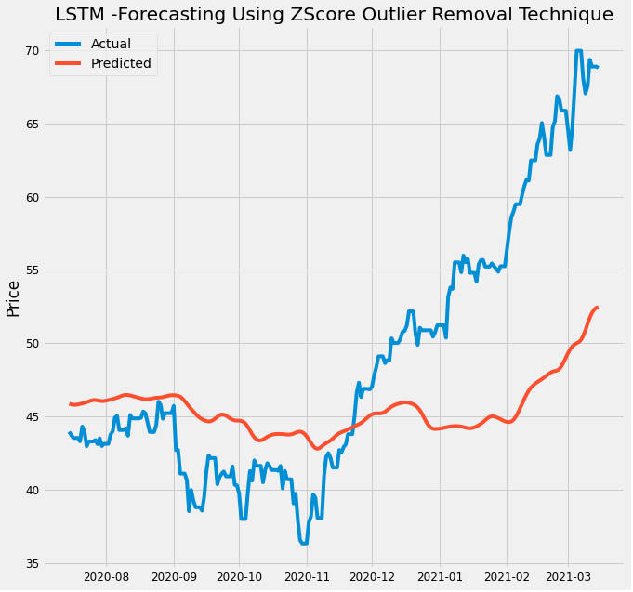
LSTM Multivariate Prediction Results
Train-test 9:1/8:2/7:1
train:test | vanilla | z-score | Mahalanobis
9:1' | 5.834 | 21.859 | 15.124
8:2' | 25.146 | 25.886 | 17.207
7:3' | 23.728 | 4.122 | 16.647

Slide 25
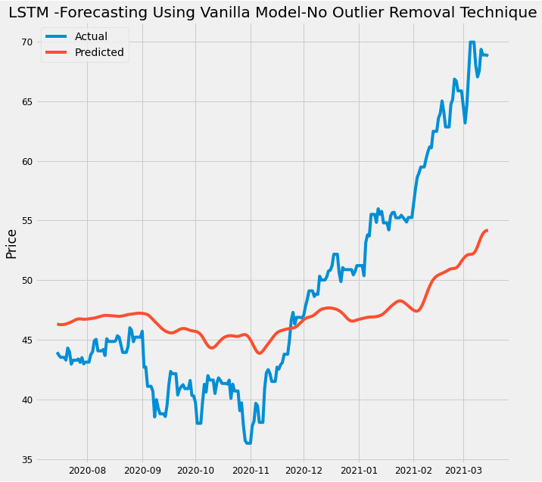
LSTM Multivariate Prediction Results
Change of Parameters
train:test | vanilla | z-score | Mahalanobis
9:1' | 5.6 | 5.734 | 15.197
8:2' | 25.377 | 24.033 | 17.288
7:3' | 24.938 | 25.095 | 13.165

Slide 26
Text analysis
04

Slide 27
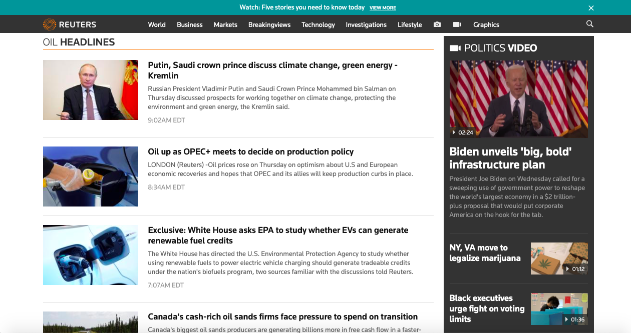
Text analysis
Scrape oil news headline from https://www.reuters.com/news/archive/oil?view=page&page=1&pageSize=10

Slide 28
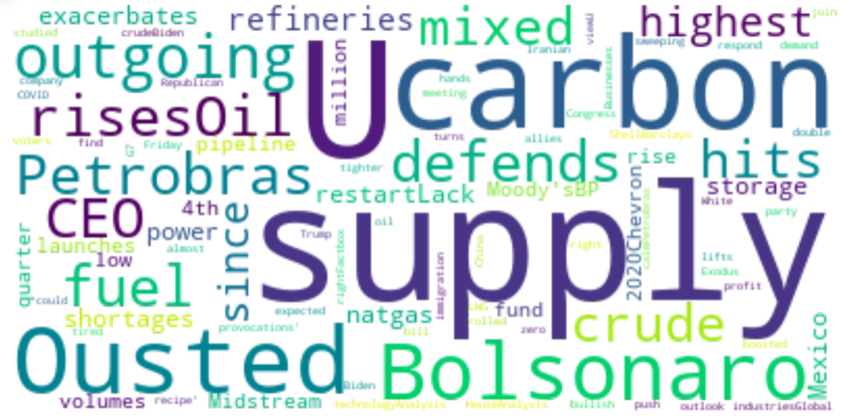
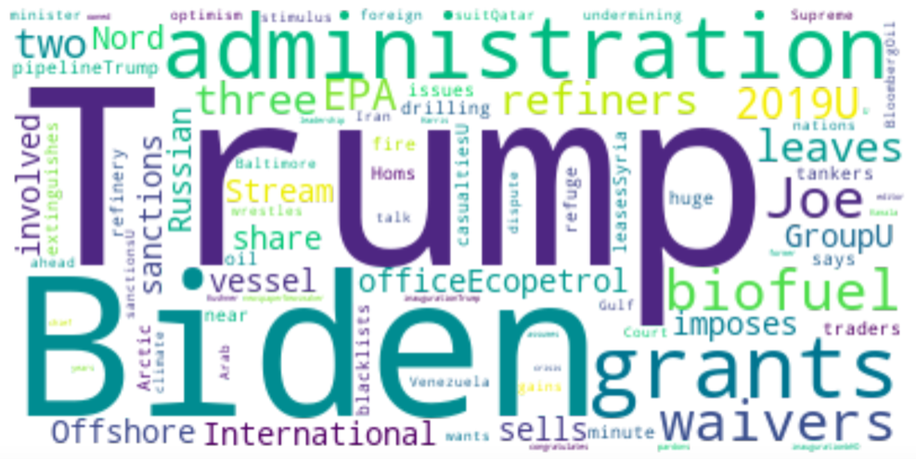

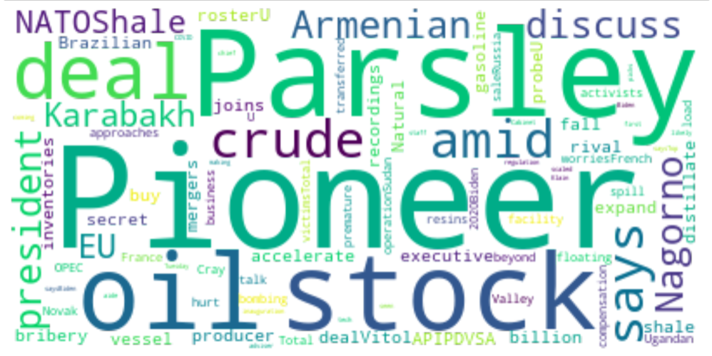

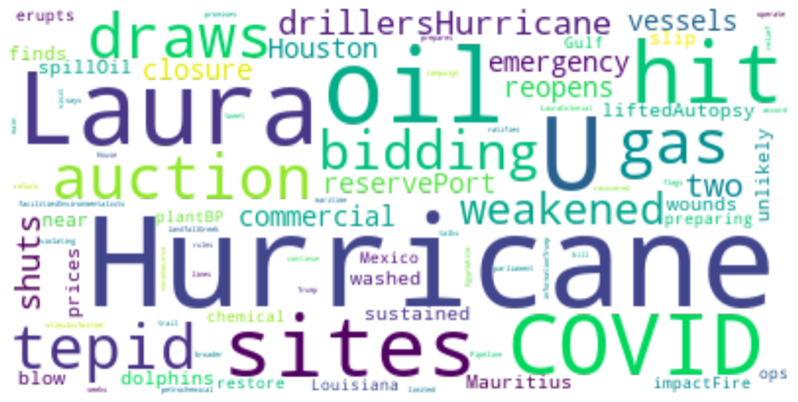
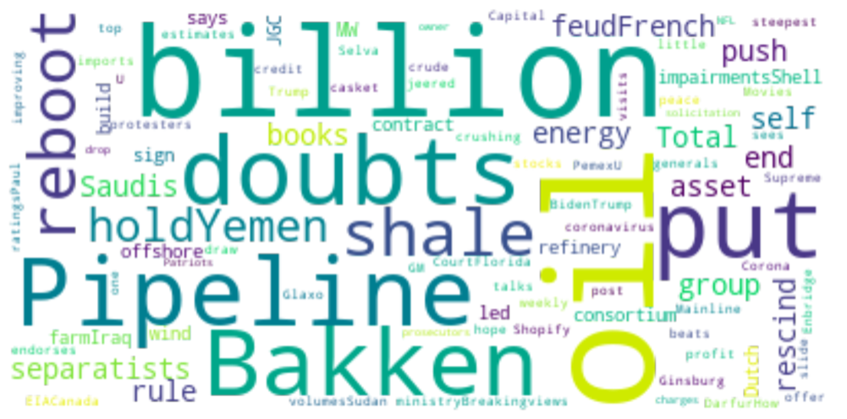
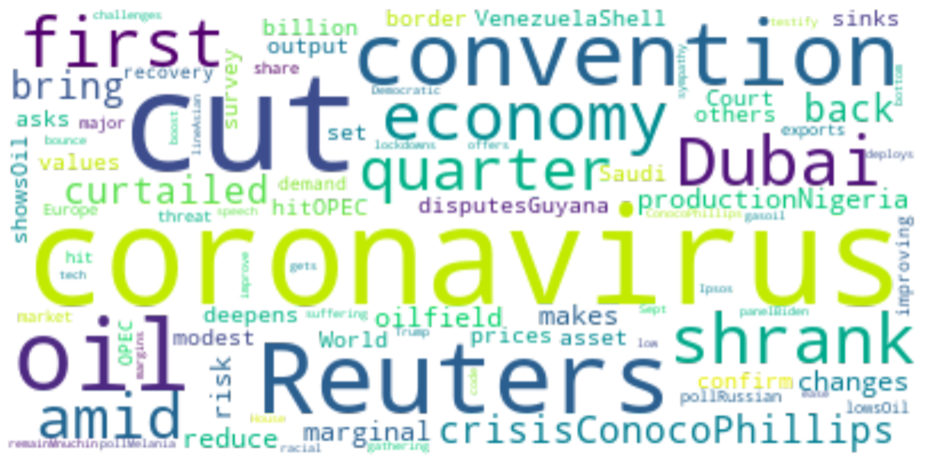
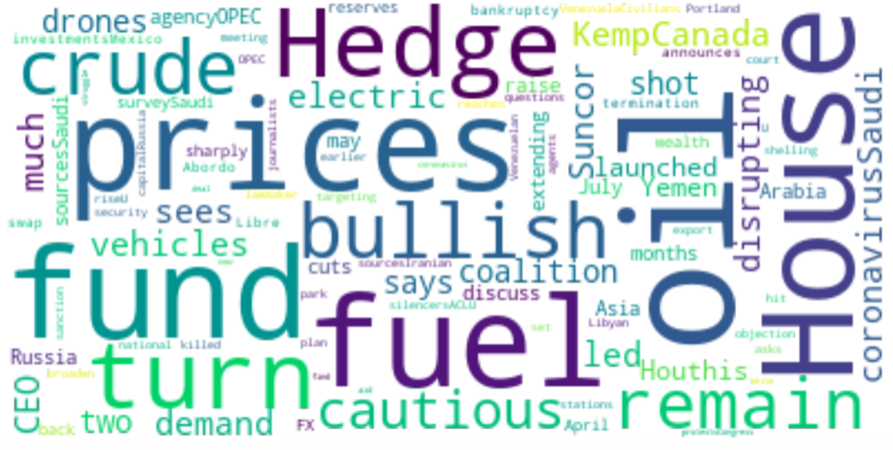
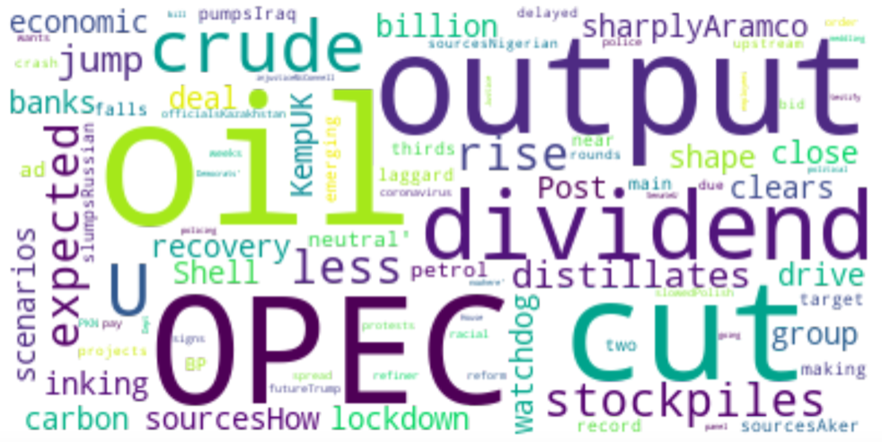
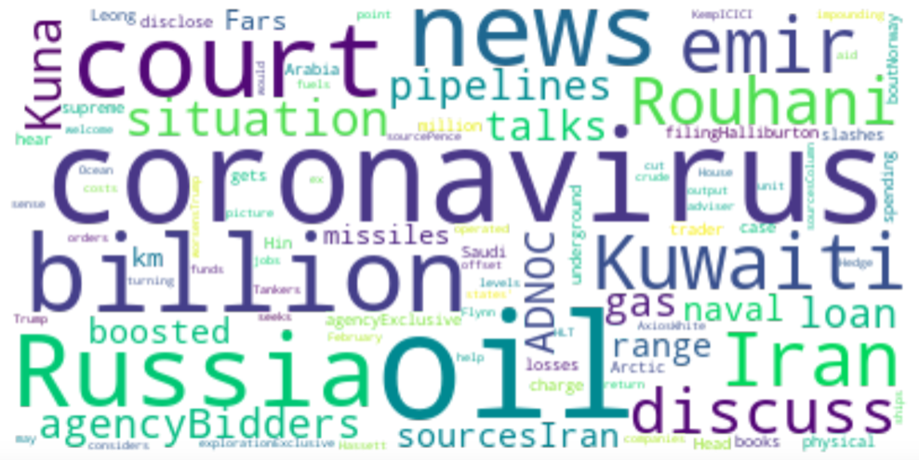
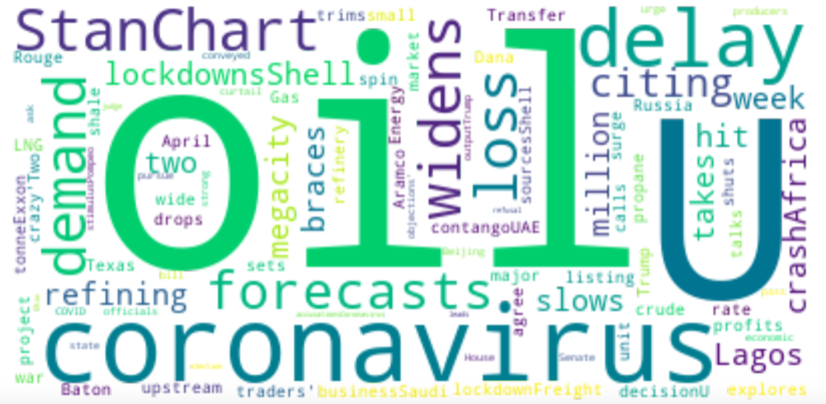
Text analysis
WordCloud pictures for each month (from 1 month ago to 1 year ago)

Slide 29
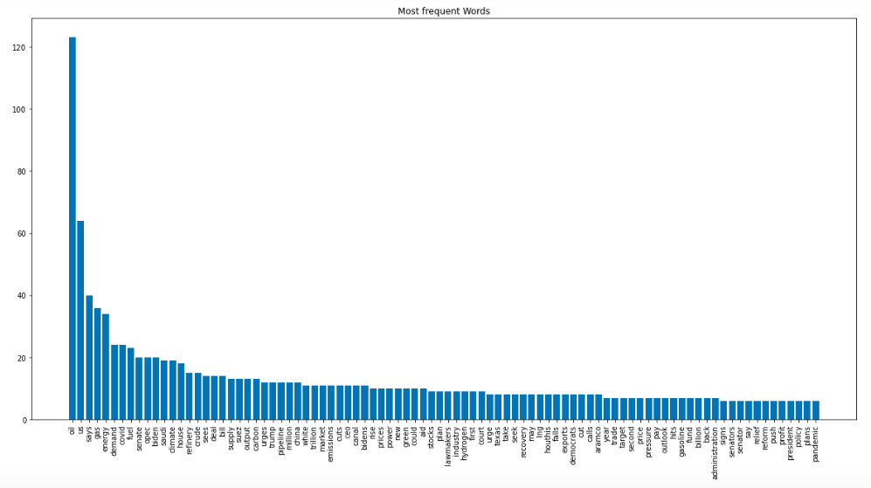
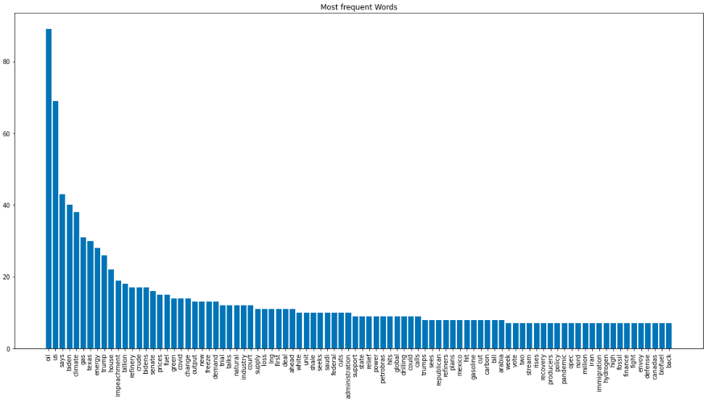
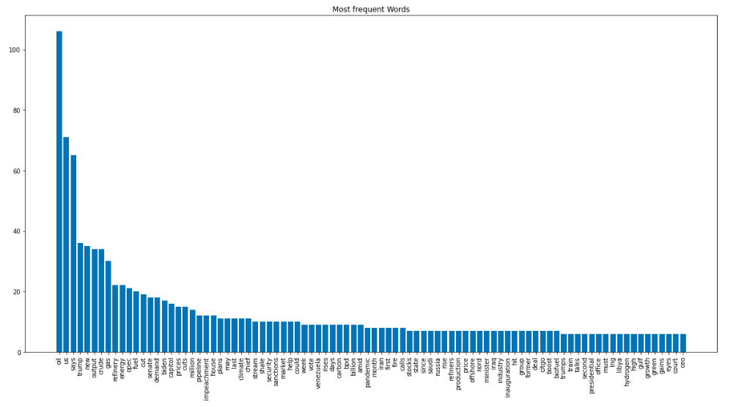
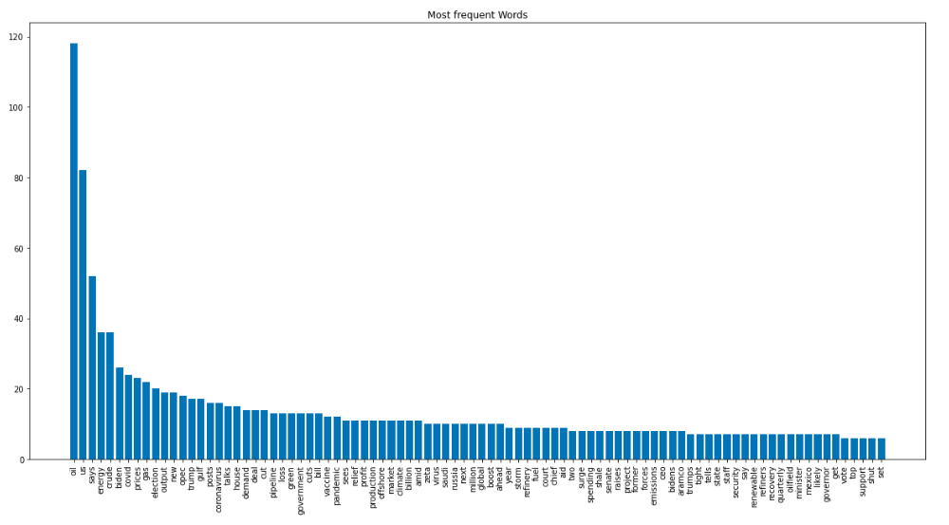
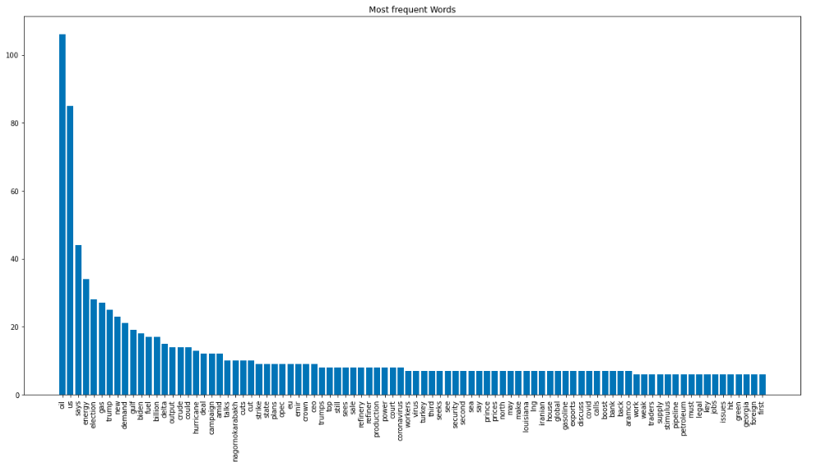
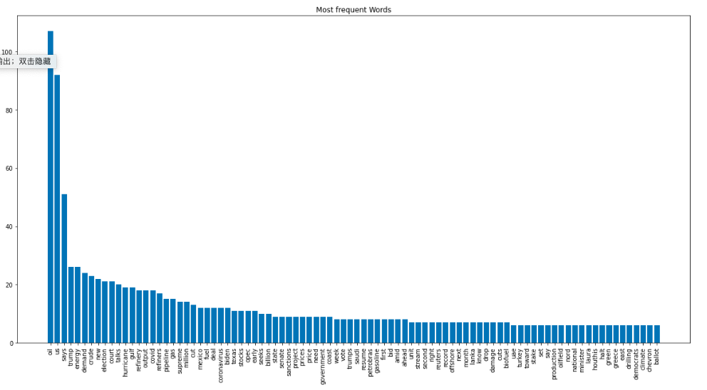
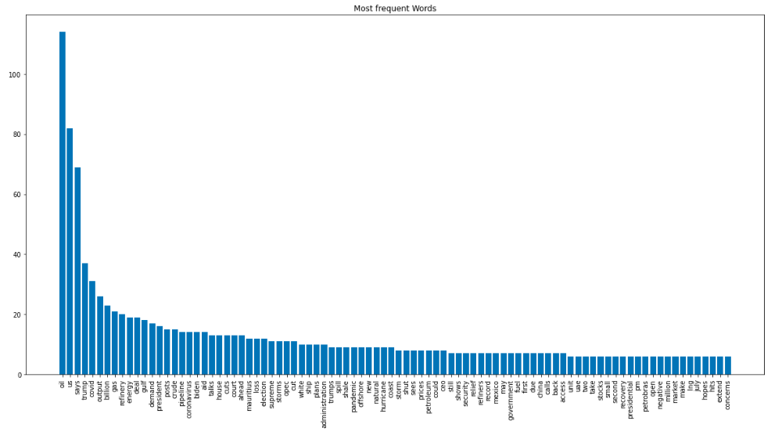

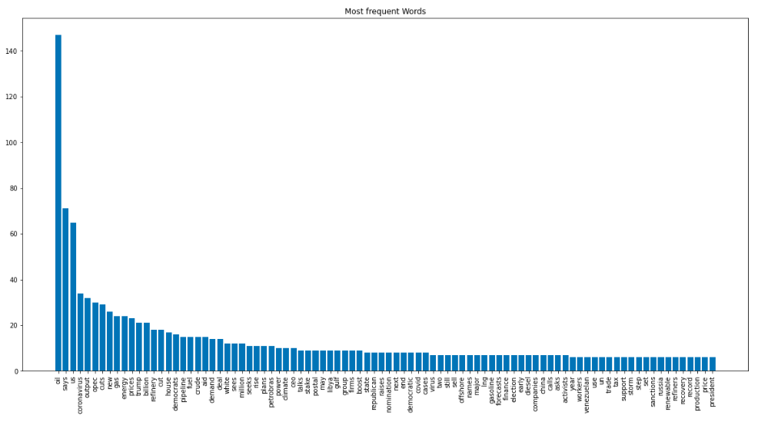
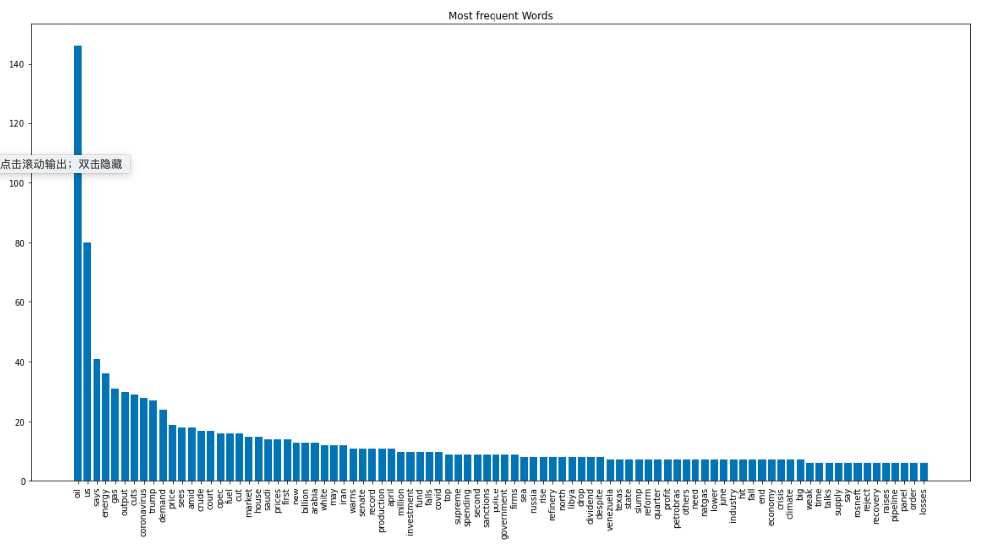
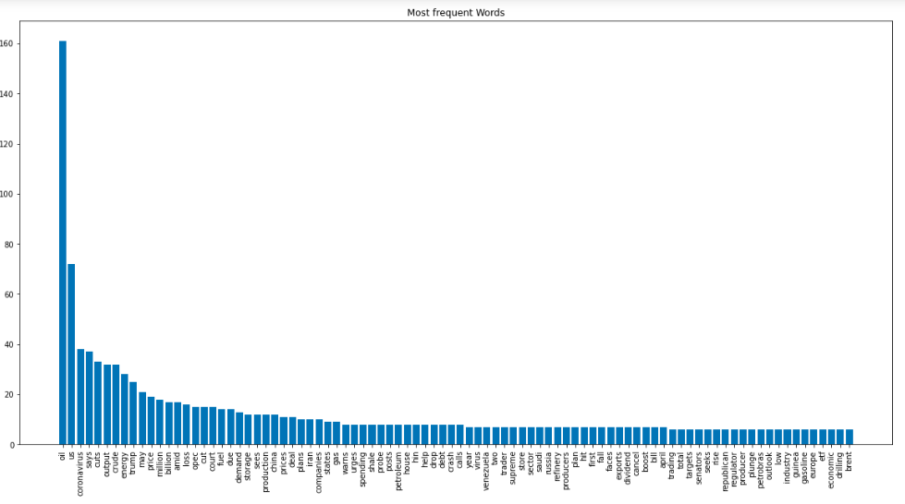
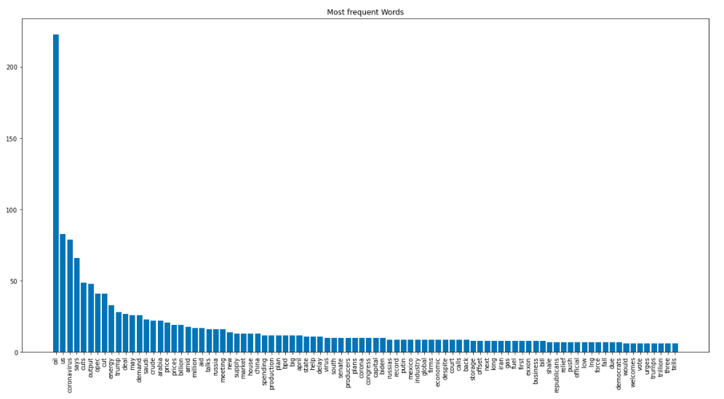
Text analysis
Word Frequency pictures

Slide 30
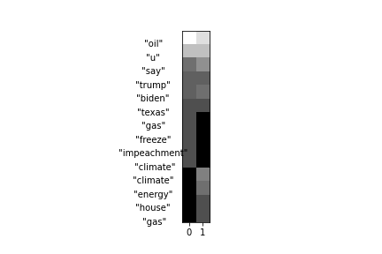
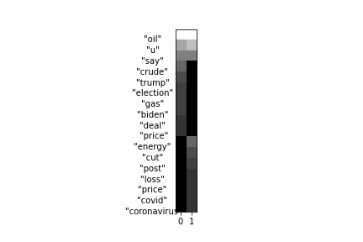
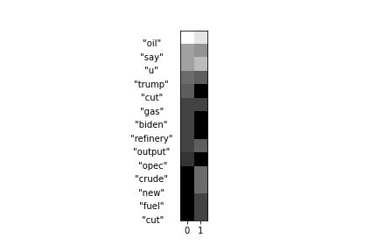
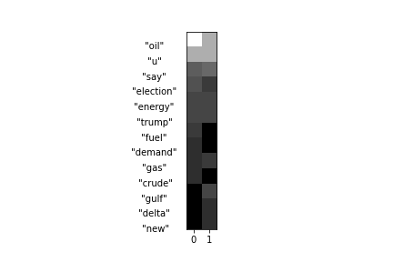
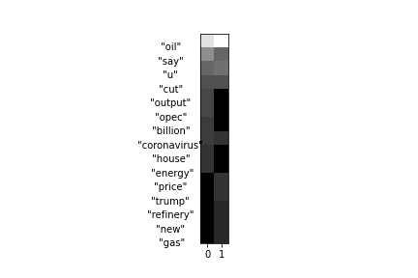
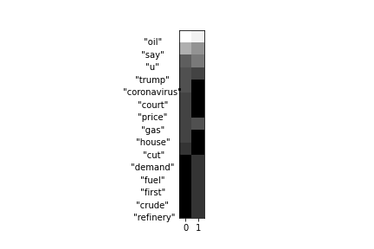
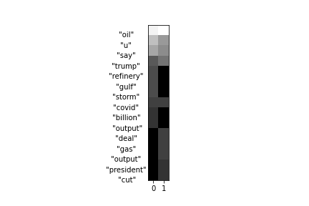
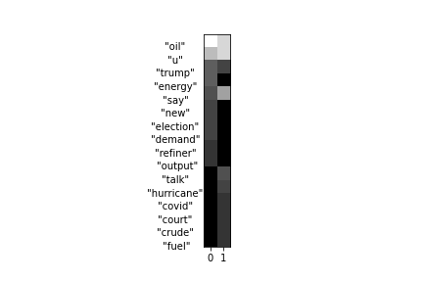
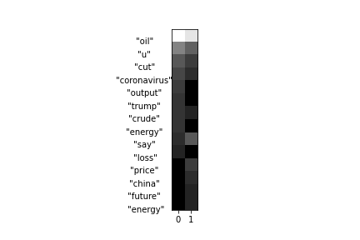
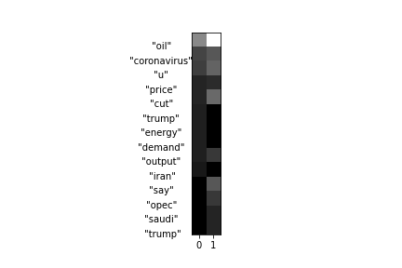
Text analysis
The result of LDA

Slide 31


Text analysis-Hierarchical Clustering
Hierarchical
Cosine Similarity
Ward’s Hierarchical clustering

Slide 32


Slide 33
Text analysis-K-means
K-means
N=7
MDS and LLE

Slide 34

Text analysis-K-means
MDS result

Slide 35

Text analysis-K-means
LLE result

Slide 36
References
https://towardsdatascience.com/only-numpy-deriving-forward-feed-and-back-propagation-in-long-short-term-memory-lstm-part-1-4ee82c14a652
https://www2.gwu.edu/~forcpgm/akv041712gwu.pdf
https://core.ac.uk/download/pdf/82641217.pdf

Slide 37
THANK YOU
Please keep this slide for attribution

